Slide 1
The Man and the Tornado
By Mike Peccatiello

Slide 2
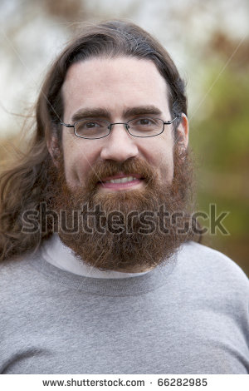
There once was a man who was short, medium height, has long hair and a beard…

Slide 3
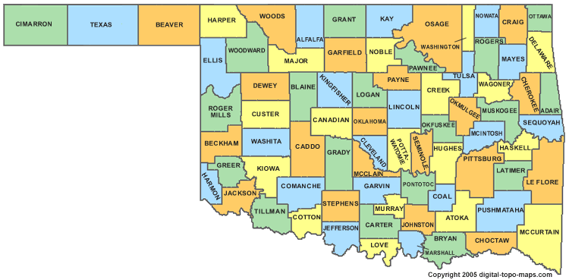
…and lived somewhere in Oklahoma.

Slide 4
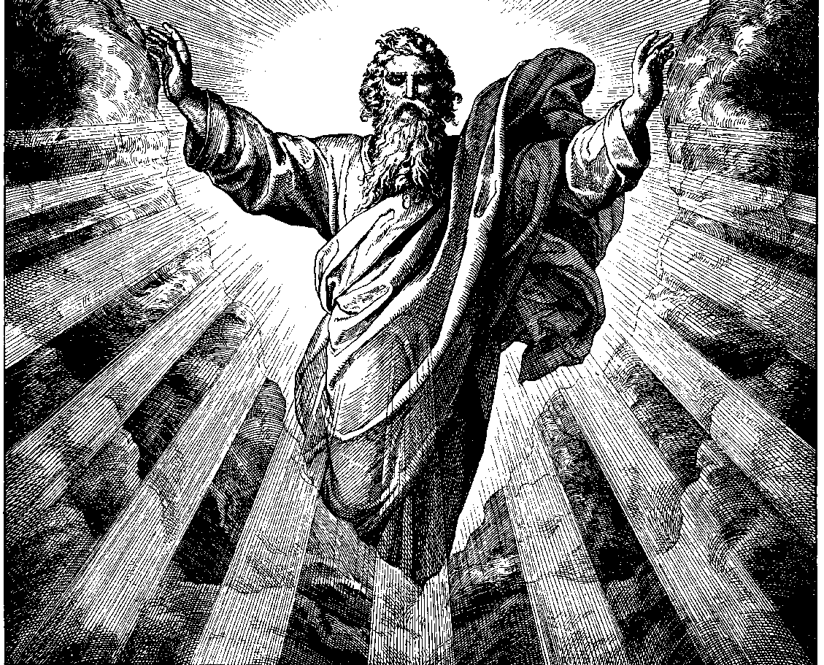
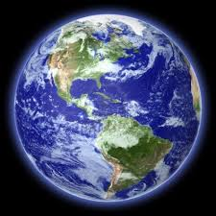
He was a god who had lived on earth in the disguise as a normal man.

Slide 5
He hated being made fun of about his religious beliefs.

Slide 6
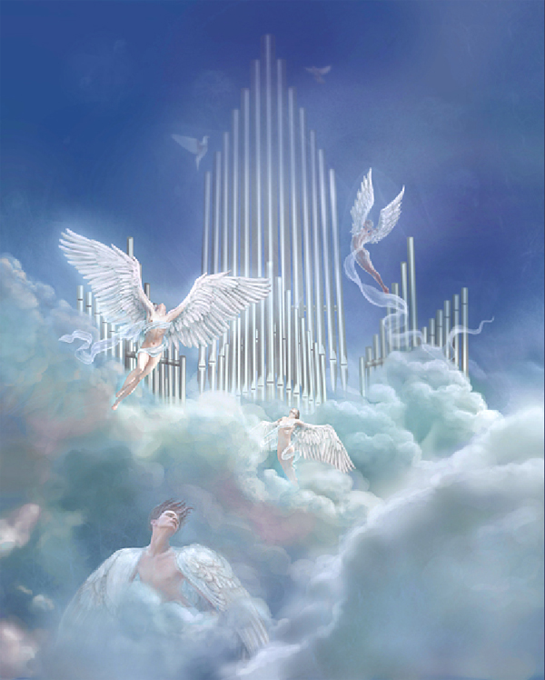
Since he was a god, he knew people from heaven.

Slide 7
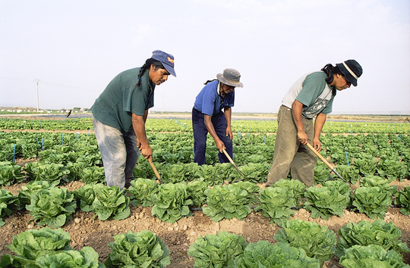
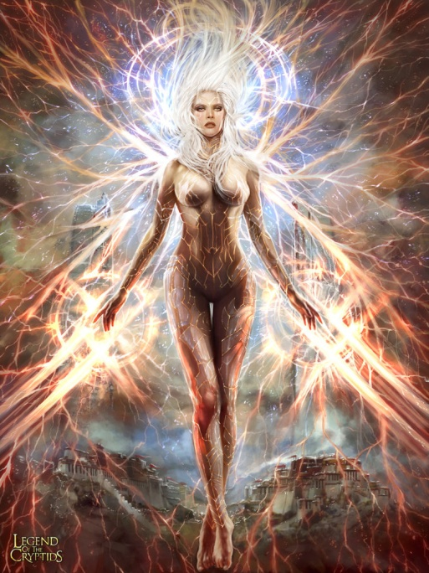
One day, the man was talking to a bunch of farmers about his pulchritude goddess girlfriend from heaven

Slide 8
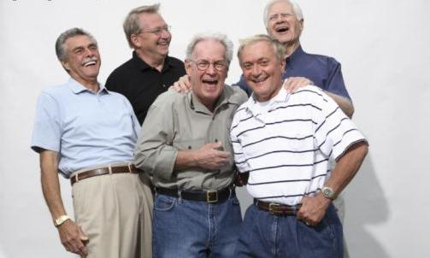
When the men laughed at the man, he got really angry

Slide 9
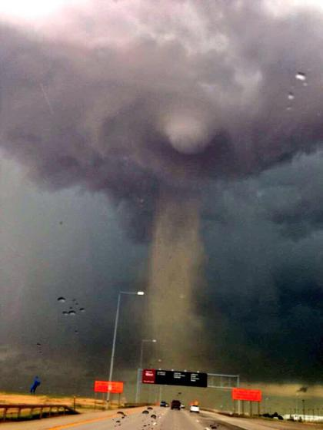
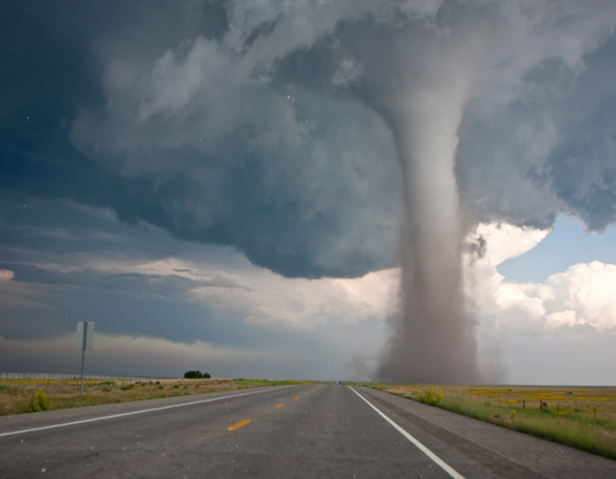
The man started breathing around in circles, and that’s when the tornado formed.

Slide 10
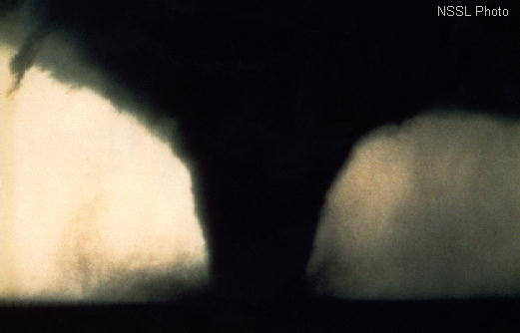
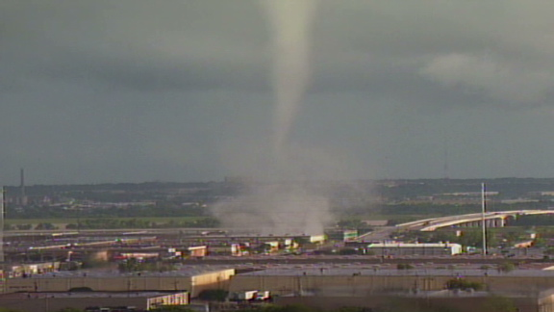
From that point on, the tornado was created every time the man got angry.

Slide 11
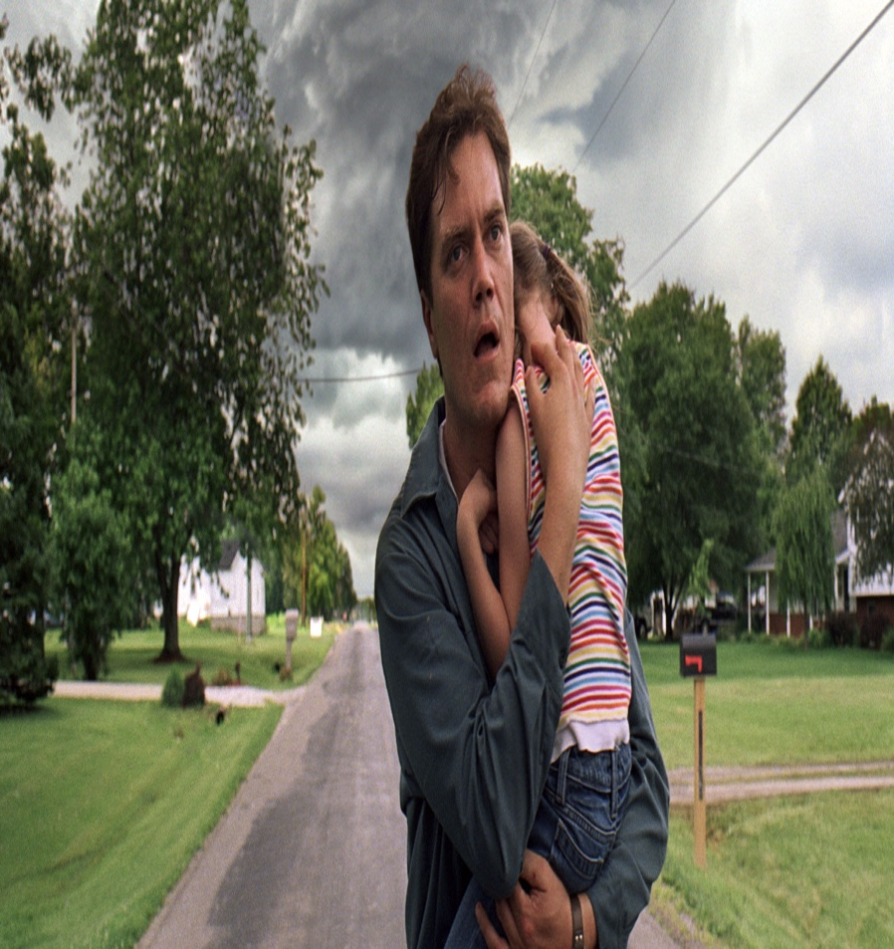
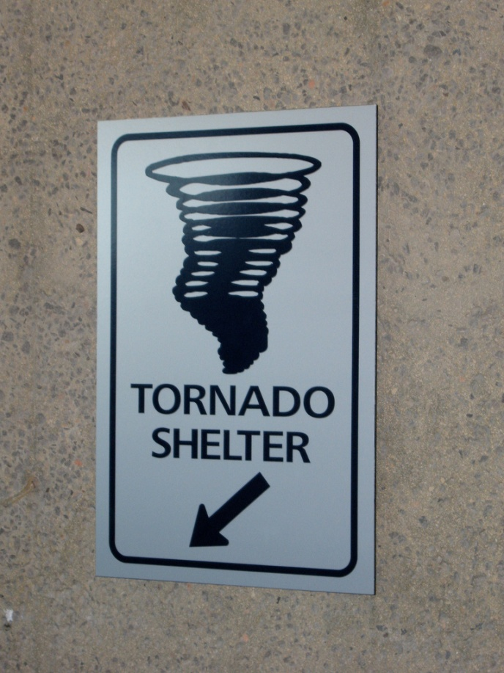
When the man sent the tornado to earth, the men on earth would run to take shelter.

Slide 12
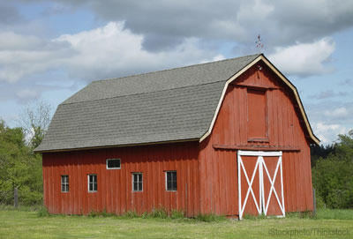
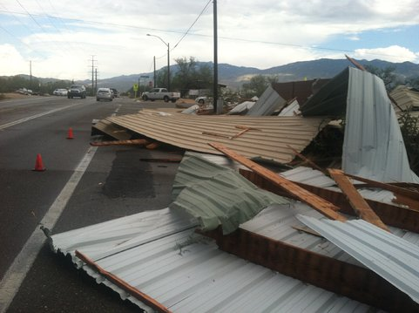
When the man is inside the barn, parts of the roof come flying off.

Slide 13
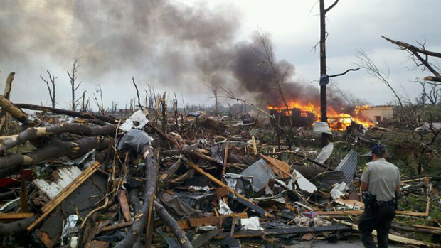
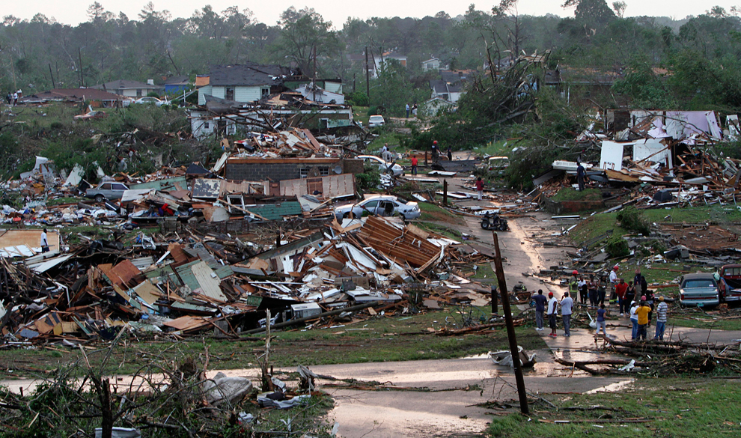
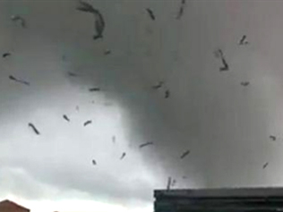
After the barn is swept away, the man gets caught inside the funnel spinning around in circles

Slide 14
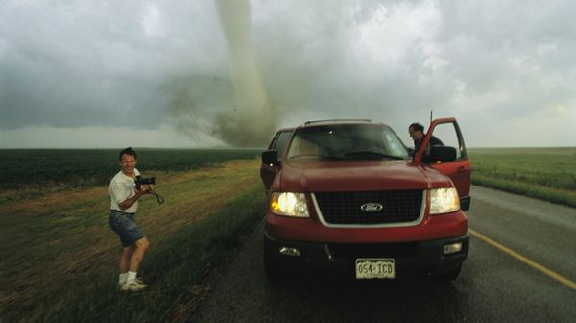
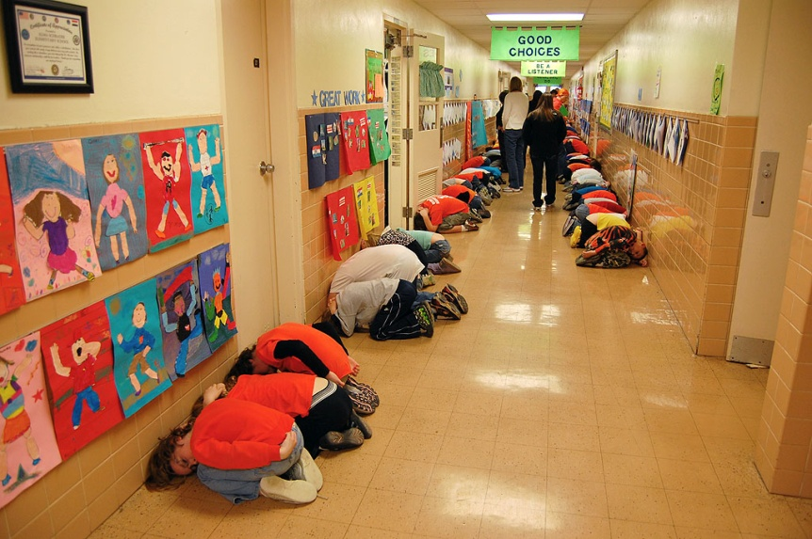
And because of this, everybody is scared of tornadoes

