Slide 1
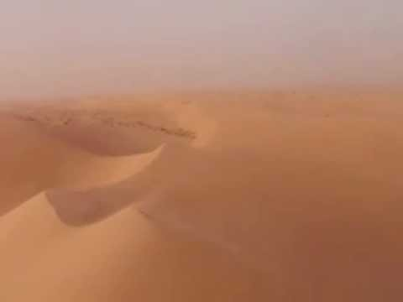
Sandstorm
By Jose Segura

Slide 2
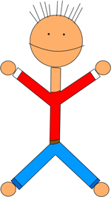
Exposition
Connor and Jack
Connor – Good
Jack – Nefarious
The setting takes place in a desert in Australia
The temperature was in the near 100 degrees

Slide 3
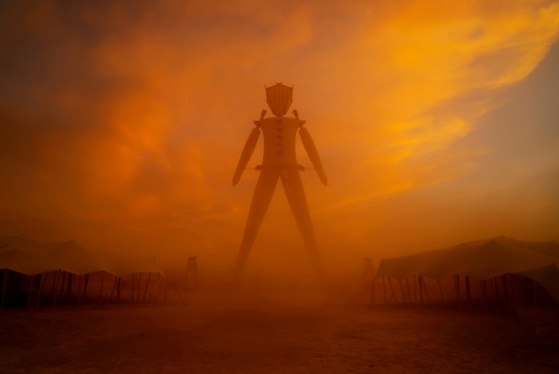
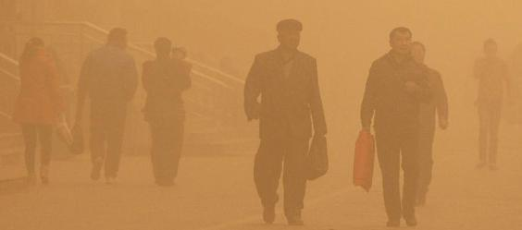
Conflict
Connor wants to save the humans from the sandstorm
Jack wants to hurt the humans in the storm to destroy the crops

Slide 4
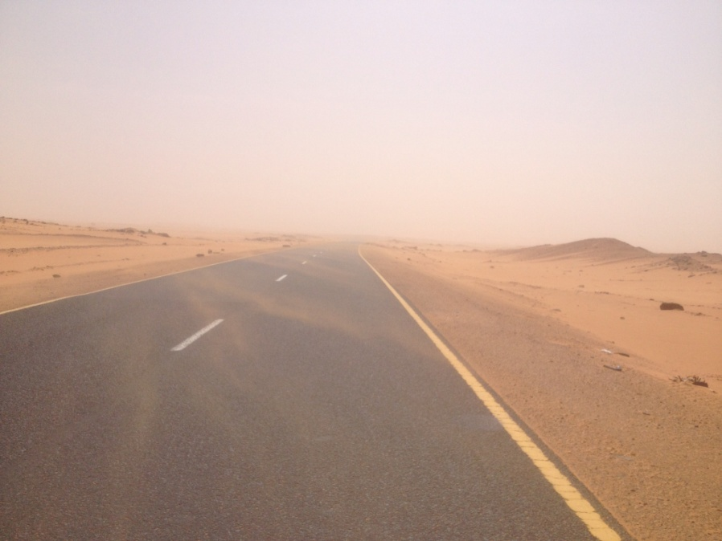
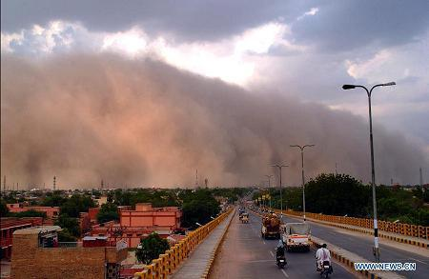
Rising Action
Connor wants the sandstorm to go the opposite way
Jack wants the sandstorm to go towards the humans

Slide 5
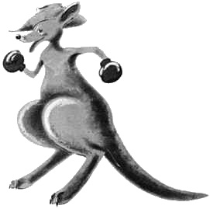
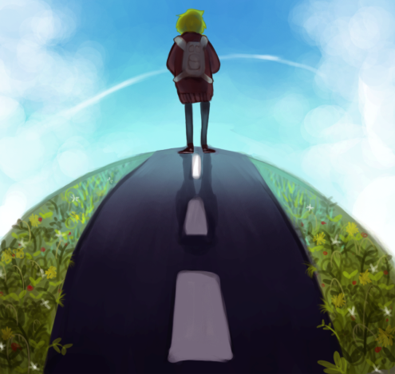
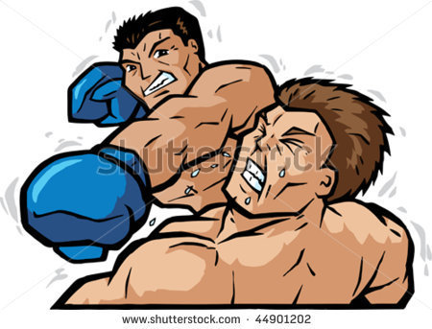
Climax
Connor and Jack decide to fight with boxing gloves to see who will control the sandstorm so the loser leaves town
Jack was making the first move to Connor, Connor punched him but Jack ducked so he punched Connor and finally, he gave him the knockout punch

Slide 6
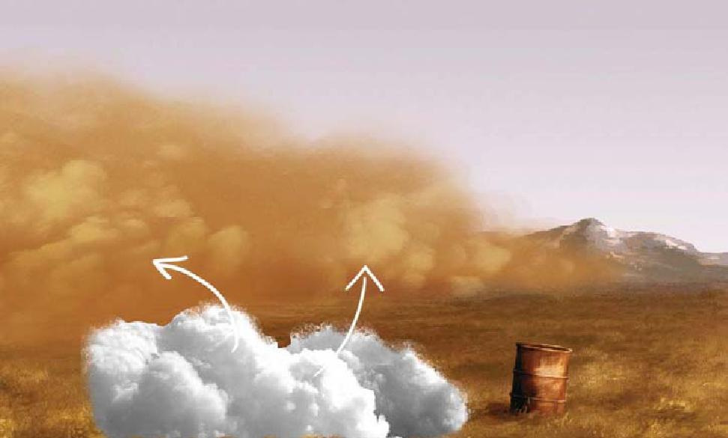
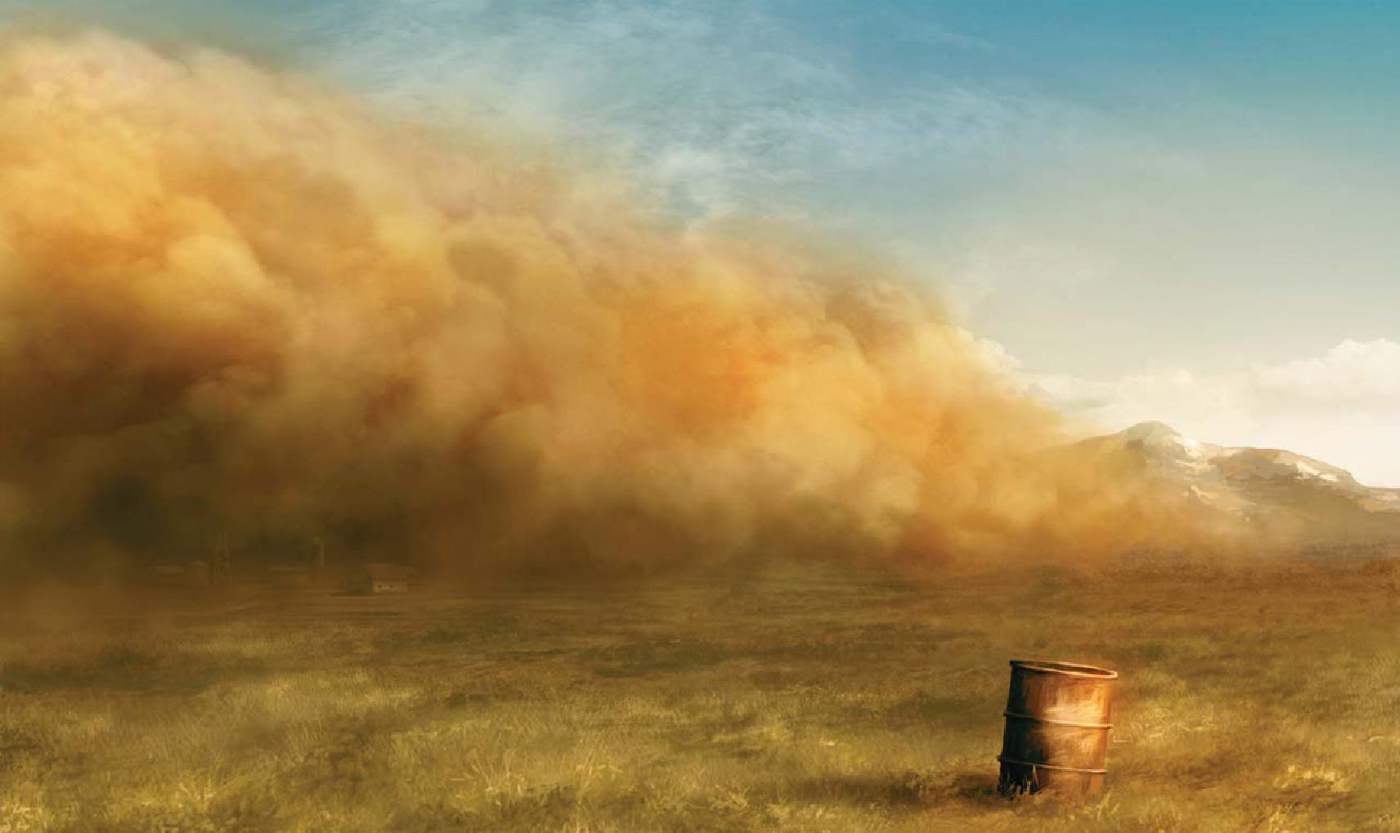
Falling Action
Now, Jack has the power to control the sandstorm
He makes the storm to destroy the crops and blow the humans away
He does this by stomping on the ground with his feet

Slide 7
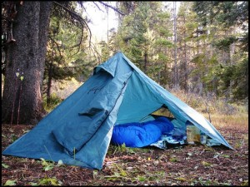
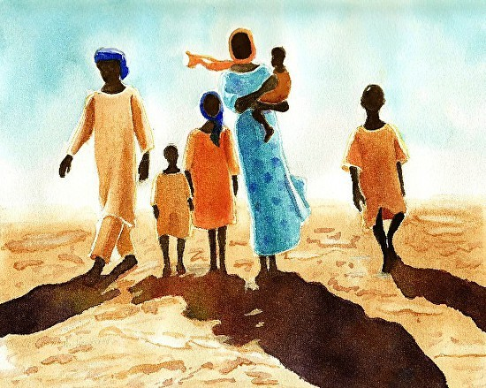
Resolution
People know that they have to hide from a sandstorm when it is coming towards you
They can find shelter or hide inside a tent

