Slide 1
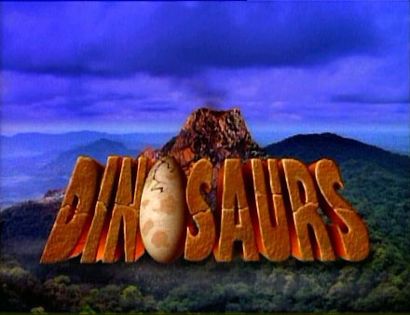
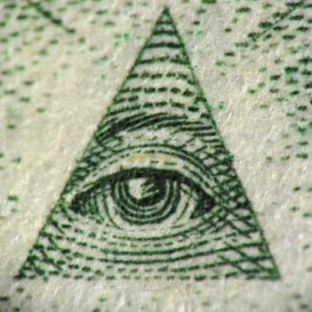
THE MYTH ON

Slide 2



José
The great Emperor alien of space, Jose, wanted to experiment with a new life form “dinosaurs.” Jose is your stereotypical alien. He is green, eight feet tall, has a big oval head and thin, tall body.

Slide 3
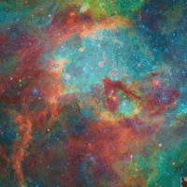
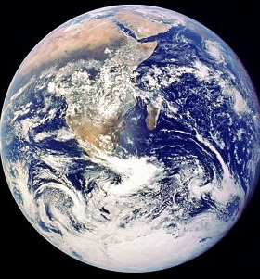
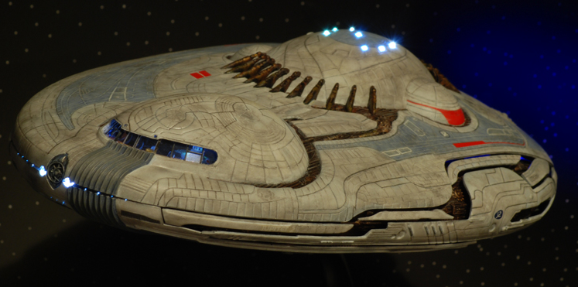

His space empire is mostly a bunch of space stations orbiting the Milky Way galaxy. They look like the death star from Star Wars, but most of them are just Earth-like planets. He didn't know what the dinosaurs were capable of so he traveled the Milky Way galaxy looking for a planet that the dinosaurs would be able to survive on. He found a planet that looked kind of like his home planet so he decided to create the dinosaurs there.

Slide 4
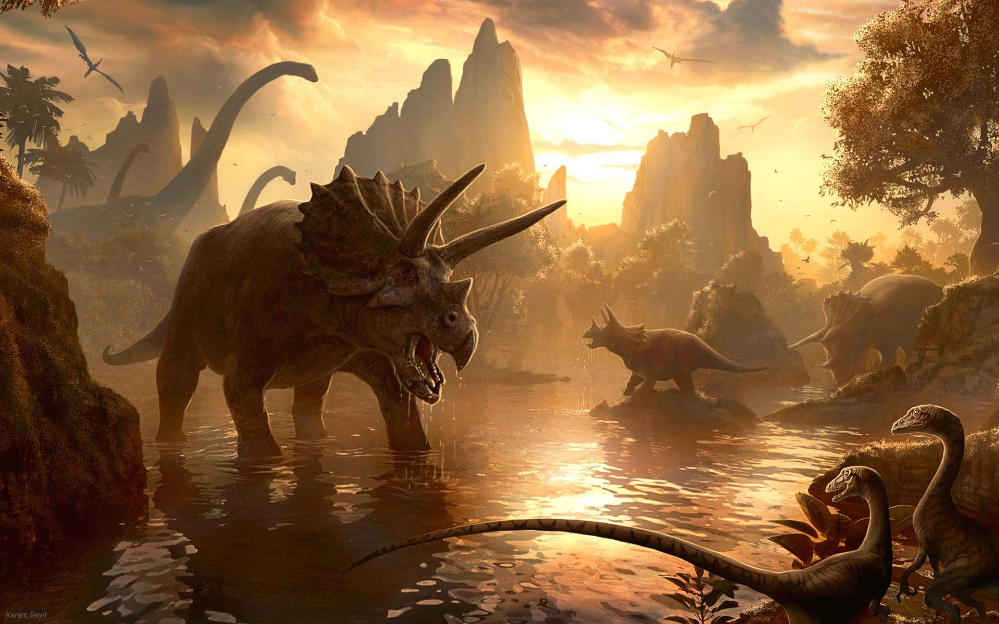
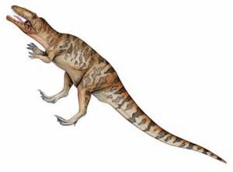
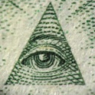
After he created the first dinosaurs on Earth, most of them died out because they had nothing to eat, so they would just eat each other. He ended creating two types of species called carnivores and herbivores, therefore, they would balance each other out. The herbivores would eat the trees and the carnivores would eat the herbivores.

Slide 5
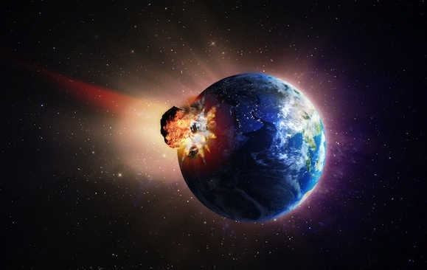
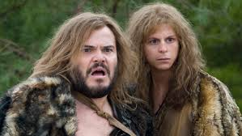
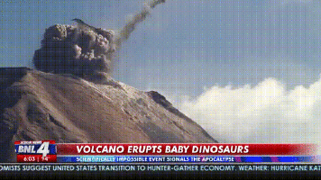
He lets them evolve for over 120 million years and he is not satisfied by the dinosaurs progress in evolution. He wanted more so he killed off all of the dinosaurs by launching a giant rock filled with minerals or single-celled organisms that started a new age of creatures on Earth. A couple million years go by and humans evolve.

Slide 6
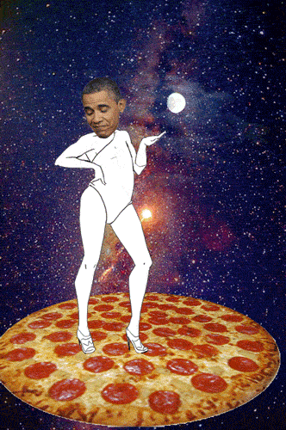
THE END

